Slide 1
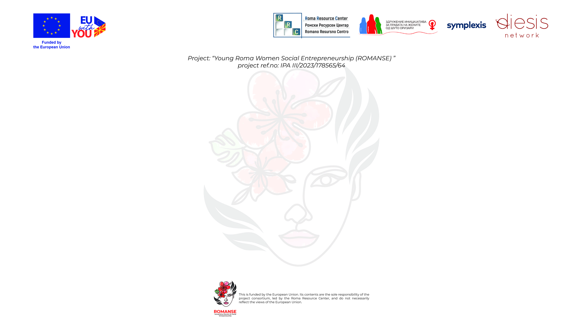

Domestic and gender-based violence

Slide 2

What is domestic violence?
Domestic violence is a set of behaviors that involve the use of force, intimidation, and manipulation in order to establish control from one person over another within a family or partnership relationship, and or shared household.
Domestic violence consists of several factors.
Psychological factors History of abuse, mental illness, addictions.
Economic factors: Financial dependence, unemployment, poverty.
Cultural factors: Traditional attitudes that justify violent behavior.
What is gender-based violence?
Gender-based violence is violence that occurs due to inequality between men and women. It is often committed against women, but can also occur against men or members of the LGBTQ+ community.
It includes domestic violence, sexual violence, persecution, psychological violence, etc.
Difference between domestic and gender-based violence:
Domestic violence occurs within family relationships (partner violence, violence against children or parents), while gender-based violence is violence that is committed on the basis of gender differences and stereotypes.

Slide 3
Forms and causes of violence
Physical violence
Hitting, slapping, hitting, and other forms of violence that leave visible consequences. It can also include child abuse, such as hitting, fighting, and other physical attacks.
Economic violence
Withholding wages, prohibiting spending money on personal needs. Withholding financial resources, preventing the victim from working or having their own income, which creates dependency and keeps the victim in a subordinate position.
Emotional and psychological violence
Manifested in the form of insults, verbal attacks, belittling, isolation from other people, manipulation, control and psychological torture
Sexual violence
Forcing intimate relationships. Includes forced sexual behavior, rape, or sexual abuse. Gender-based stereotypes, such as the assumption that men have a right to women, often fuel this violence.

Slide 4

Economic violence
Withholding wages, prohibiting spending money on personal needs. Withholding financial resources, preventing the victim from working or having their own income, which creates dependency and keeps the victim in a subordinate position.
Stalking
This involves attempting to be close to the victim causing serious damage to the person’s way of life, which indirectly, directly or virtually causes distress, fear or injury to the person targeted by the attack. This can be done in particular by attempting to establish contact in any way possible, abusing the victim’s personal data to order goods or services, or by forcing a third party to contact the victim in order to threaten them or someone close to them.
Neglect
(especially of children and the elderly) neglect, disregard for care. Includes neglect of the basic needs of family members, such as children or the elderly, who may be exposed to unsanitary conditions, starvation, or lack of care.
Online violence
Spreading lies or posting embarrassing photos of someone on social media, sending hurtful or threatening messages via messaging platforms, assuming someone else's identity and sending malicious messages to others in their name.

Slide 5
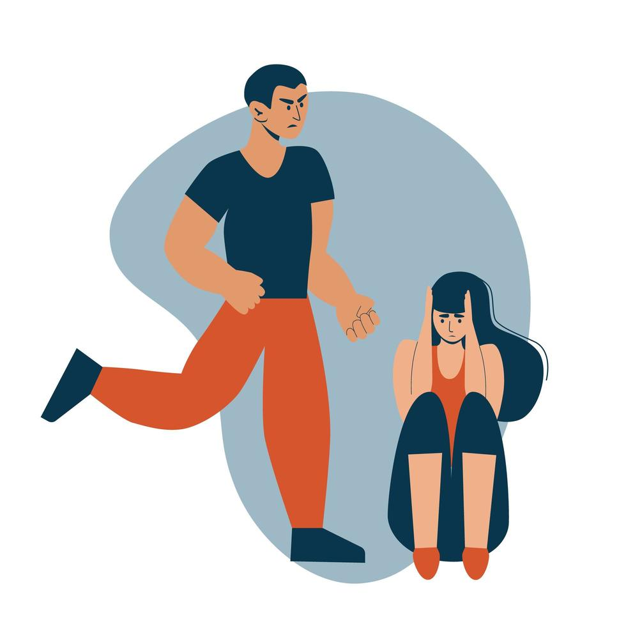
Gender stereotypes and discrimination:
Stereotypes about gender roles in society can lead to inequality and violence. These stereotypes often limit women and girls, creating feelings of worthlessness or dependency.
Unregulated social status:
Women, children and some social groups are more exposed to violence, especially in countries or regions with weak social protection or high levels of economic inequality.
Causes of violence
Psychological and emotional factors:
People who are exposed to violence or abuse in childhood sometimes develop violent attitudes and habits. Psychological disorders and addictions (for example, to alcohol) can also be factors.
Historical and cultural factors:
Some cultures and societies have deep roots of gender inequality, which is reflected in various forms of violence. Violence can be normalized and accepted as part of tradition.

Slide 6

Consequences of violence
Physical consequences: Injuries such as broken bones, bruises, burns, and other serious physical injuries. There may be long-term health problems, such as damaged organs or chronic pain.
Psychological consequences: Post-traumatic stress, depression, anxiety, impaired self-esteem and permanent psychological wounds that often last a lifetime.
Social consequences: Problems in relationships and social interactions, such as isolation and distrust. Victims may feel lonely and unsupported.
Economic costs: Violence has a large cost to society, including the costs of health care, legal services, policing and lost productivity.

Slide 7



How to react?
Recognizing the signs of violence: Recognizing the physical and psychological signs of violence is key to timely intervention.
Victim support: Support through legal services, psychological support and evacuation of victims to safe adapted spaces.
Vulnerable populations: Special support for children, the elderly, migrants, LGBTQ+ people, who are vulnerable to greater forms of violence.
Conclusion:
Domestic violence and gender-based violence is a serious problem that requires a coordinated and integrated approach from all segments of society.
It is necessary to create a culture of tolerance, respect and equality, where violence will not be tolerated.

