Slide 1

Session 8: Self-awareness and empowerment
Women’s rights –Human rights

Slide 2
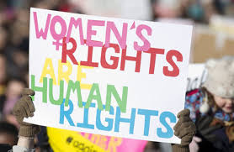
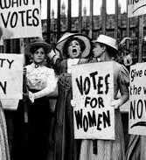
Women’s rights
“Where, after all, do universal human rights begin?
In small places, close to home - so close and so small that they cannot be seen on any maps of the world. Yet they are the world of the individual person; the neighborhood he lives in; the school or college he attends; the factory, farm, or office where he works. Such are the places where every man, woman, and child seeks equal justice, equal opportunity, equal dignity without discrimination. “ Eleanor Roosevelt

Slide 3
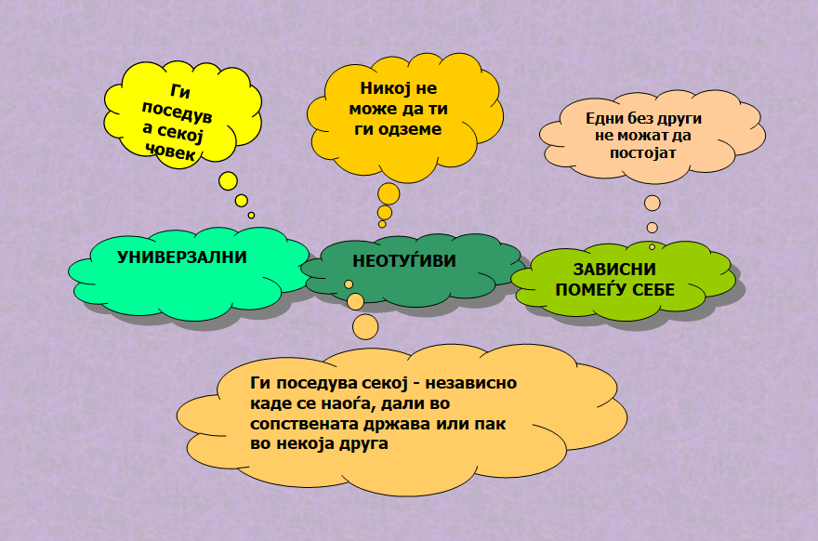
Women’s rights and empowerment
Why are women's rights specifically defined?
Why should women's rights be specifically discussed?
What is Women’s Empowerment?
Process by which women gain power and control over their own lives and acquire the ability to make strategic choices.
Women’s empowerment has five components:
Women’s sense of self-worth;
Their right to have and to determine choices;
Their right to have access to opportunities and resources;
Their right to have power to control their own lives, both within and outside the home;
Their ability to influence the direction of social change to create a more just social and economic order, nationally and internationally.

Slide 4
SEX
GENDER
Sex is biological, physiological and anatomical. We are born with a SEX
SEX is unchangeable (in the absence of medical intervention)
Examples: male, female, intersex
Gender is a social construct. We learn GENDER
GENDER is changeable and dynamic – and varies within and between cultures and contexts
Examples: man, woman, masculine, feminine, transgender

Slide 5
Intersectionality and(non)discrimination
What kinds of socio-demographic factors can put people at risk of insecurity/injustice?
Gender as a social construct intersects with other social variables/traits.
This approach considers the way in which different socially and culturally constructed categories intersect and form different forms of inequalities and multiple discrimination.

Slide 6
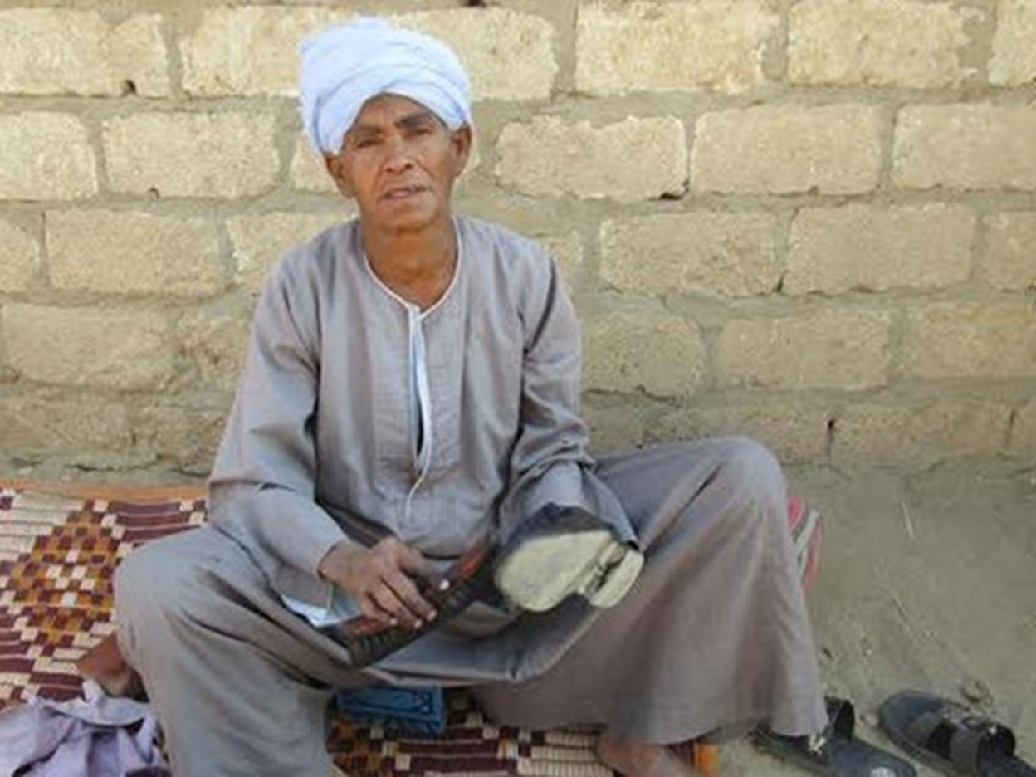
Discussion : What do you see on the photo? A Man or a Woman? Exercise no.1 Which of the following statements refer to sex and which refer to gender Annex : Statements

Slide 7
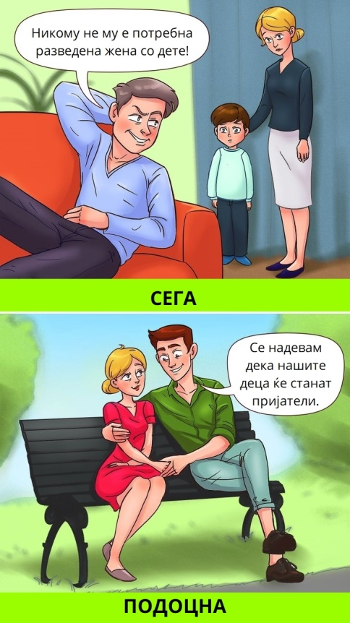
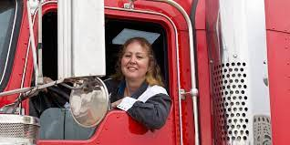
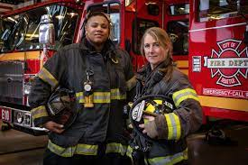
Gender stereotypes Gender Prejudices
A gender stereotype is a generalized view or preconception about attributes, or characteristics that are or ought to be possessed by women and men or the roles that are/or should be performed by men and women. Gender stereotypes can be both positive and negative for example, “women are nurturing” or “women are weak”.
Prejudice can be defined as “a negative evaluation of a social group or a negative evaluation of an individual that is significantly based on the individual’s group membership
A Gender prejudice is a judgment (usually negative) about someone before having any information on which to form a knowledgeable opinion.
Examples of prejudice: Women are meant to be housewives; women are emotional, men are rational

Slide 8
Exercise no.2 Barometer
Objective of the exercise:
Strengthening sensitivity to gender issues and gender based discrimination
Activity Annex:
List – I agree
List – I disagree
Statements

Slide 9


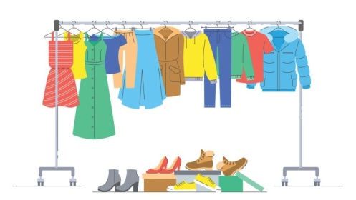
Gender roles Gender needs
Gender roles are defined as norms or beliefs in a given society/community or other distinct group that condition which activities, tasks and responsibilities are perceived as masculine or feminine.
A reproductive role is related to biological functions. It also refers to the care and maintenance of the household, care for children and the elderly.
A productive role includes all tasks related to generating income and ensuring economic well-being.
A community role (social role) is related to participation in the community, social events, inclusion in groups and organizations.
Practical needs
Strategic needs:
The needs related to the status of men and women in society and their positions within the power structures of society.
These are gender-specific needs that include gender re-division of labor, legal rights, ending domestic violence, equal pay, and rights related to reproductive health.

Slide 10
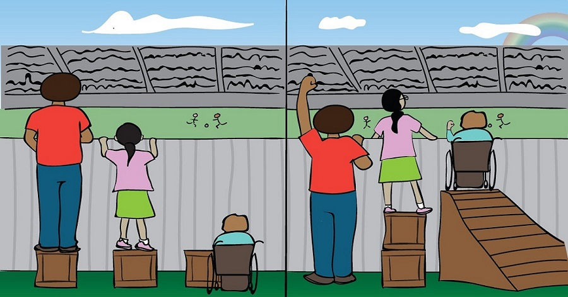
Gender Equality Gender Equity
Gender equality means that the rights, responsibilities and opportunities of individuals will not depend on whether they are male or female, handicapped or able bodied, young or elderly, white or black, or from rural or urban settings. Women are entitled to live in dignity, safety and security.
Gender equity is the process of being fair to women and men
according to their respective needs.
To ensure fairness, strategies and measures are needed to compensate for
women's historical and social disadvantages that prevent women and
men from otherwise operating on a level playing field.

Slide 11
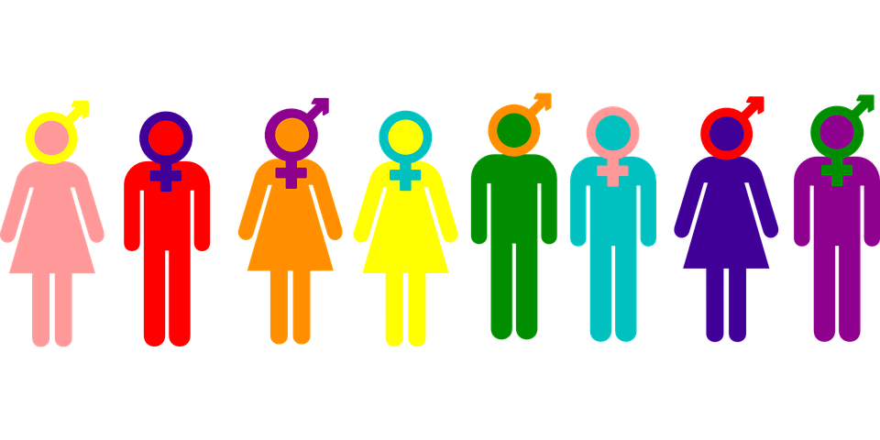
Equal opportunities
It’s not about making people the same…
Simply… Rights and opportunities do not depend on your gender or other social factors.
Equal opportunities for women and men mean equal enjoyment of rights and opportunities by all individuals. Equal opportunities and equal treatment prevent direct or indirect discrimination on the basis of sex and gender, they mean the absence of obstacles to economic, political, social participation.

Slide 12
Exercise no. 3 Tower of Power (Group work)
Objectives:
To determine who makes the majority of financial decisions and manages resources in the household.
To recognize that one’s gender can negatively impact access to resources and participation in decision-making
Activity Annex : Questions and roles

Slide 13
Gender Responsive Budgeting
WHY GRB?
Increasing the allocation of resources to women and shedding light on women's invisible contributions to society (the care economy);
Poverty reduction;
Equitable distribution of budgetary resources in a fair and equitable manner;
Increasing transparency, accountability and responsibility
Investments in human development
What is a budget? What is gender responsive budgeting?
Gender-responsive budgeting is a strategy that creates budgets that work for everyone. By considering and analyzing the unique and diverse needs of every person, gender-responsive budgets strive for a fair distribution of resources.
An innovative public policy tool that addresses gender bias and discrimination.
What is not GRB?
It is not a separate budget for women
It does not necessarily require an increase in the amount of money spent on women
It is not a goal in itself
It does NOT refer to dividing government money between women and men on a 50/50 basis.

Slide 14
Exercise no. 4 Domestic budget and creation of ,,governmental” budget (Group work)
Creation of a household budget and a state/governmental budget
Prioritizing private household expenditures and prioritizing state/municipal expenditures
Objective of the exercise : learning and recognizing gender perspective in budget allocation
Activity Annex: Lists with instructions
Closing the session - feedback

