Slide 1
CAPACITY BUILDING TO CSOs Session 6
Development of Digital and Financial Literacy for CSO

Slide 2
OBJECTIVES OF THE FIRST SESSION
Understand what is financial management for nonprofit organization
Basic theoretical & practical skillset of NPOs financial management
Sharing of experiences on financial management procedures for NPOs

Slide 3
Basic steps of financial management for nonprofits
Proper and sound financial management is a key requirement for any CSO regardless of the size and specialisation of the organisation. Proper financial management ensures that an organization has necessary financial resources and all necessary financial processes that promote financial and operational transparency and help build trust with donors, funders, stakeholders and the public. Here we will look at 4 key best practices for financial management of nonprofits by name. Whether your organization is established or just starting out, these tips will help you use your resources in the most effective ways to advance your mission.
These best practices are:
Organizing Financial Management Team
Diversifying of Revenue Streams
Proper Financial reporting
Establishing Fiscal Policies

Slide 4
Organizing Financial Management Team
Even if your CSO/NGO is small you should organise a team to deal with financial management to be efficient and check each other's work to reduce potential mistakes. The four key members of your organization's financial management team are
Financial Management Team
The treasurer
The financial manager
The accountant
The Bookkeeper
Treasurer: with excellent financial knowledge is normally a member of the Board and is responsible for overseeing the management of resources. Approves budgets and implements financial risk management plans
Financial manager an executive of the organisation close partner of the executive and leadership team of the organisation organises the financial strategy, manages grants and forecasts potential cash flows
Accountant: qualified in the science of accounting with a professional license who maintains the organised financial records of a CSO while managing invoices or making bank deposits
TIP!:Small to mid-sized nonprofits often don't have the budget or need to hire an accountant or bookkeeper so they may outsource to trusted external partners with expertise and experience in nonprofits.
Bookkeeper: responsible for financial analysis and reporting, balancing transactions in your accounting software and submitting tax forms and preparing for financial audits.

Slide 5
Establishing Fiscal Policies
Financial policies that characterize how resources are managed by role in your organisation are standard practice. These policies are the financial management manual that your team must refer to and use. As a general rule, certain policies are recommended for nonprofits such as:
Fiscal Policies
Gift Acceptance Policy: outlines the types of contributions (both cash and in-kind) that your nonprofit can and cannot accept, as well as the terms under which you will accept each donation.
Conflict of interest policy: establishes the process for leaders and board members to disclose conflicts of interest and next steps to mitigate those conflicts.
Expense Reimbursement Policy: explains when and how employees and volunteers can be reimbursed for expenses incurred on behalf of your organization.
Staff Reimbursement Policy: Details how you will determine and increase salaries and benefits for your nonprofit's employees.

Slide 6
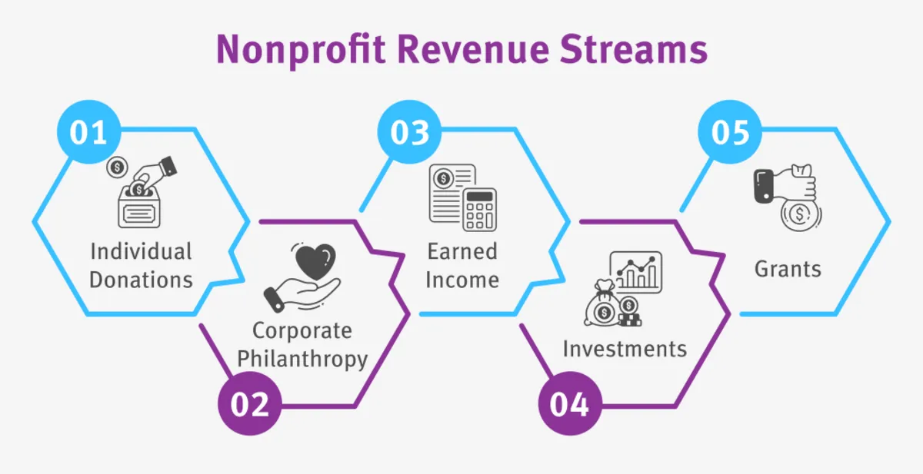
Diversifying of Revenue Streams
The challenge for an NPO CSO is financial stability which can offer you the diversified funding model to provide alternatives in terms of revenue sources and reduce expenses. Your funding model should include some combination of the five major nonprofit revenue streams, which are:

Slide 7
Diversifying of Revenue Streams
The challenge for an NPO CSO is financial stability which can offer you the diversified funding model to provide alternatives in terms of revenue sources and reduce expenses. Your funding model should include some combination of the five major nonprofit revenue streams, which are:
1
Individual donations: In several NPOs, individual donations, regardless of size, make up a large part of their funding, as well as donations from non-profit events and in-kind donations.
2
Corporate philanthropy: This includes all charitable contributions from large for-profit companies that provide sponsorships, gifts and sponsor volunteers.
3
Earned income: In NPOs this income comes mainly from membership or volunteer fees.
4
5
Investments: Though as a rule investments are not an income stream of NPOs however some experienced organizations opt for low-risk investments through treasury bills and mutual funds.
Grants: Grants usually come from foundations or government agencies and often make up the bulk of an NPO's income. These are e.g. EU Funded projects.
TIP!: When creating your organisation's annual budget, categorise your income by source to set targets more effectively. In addition, make sure your total projected revenue exceeds your total projected expenses to create a cushion in case of an emergency.

Slide 8
Proper Financial reporting
An NPO's financial reports are very essential for government financial services and the Tax Authorities, but also for the financial transparency and profile of the organization itself. Governments in each country set regulations for tax-exempt organizations and you need to check that your NPO complies with them to continue to provide it with this status. At the same time, grant donors check these reports to confirm that their funding is being utilized in the correct and intended manner under their regulations. To meet these needs you prepare the following comprehensive, accurate financial reports each year:
Financial statements that describe and summarize your organization's financial activities, operations, financial position, cash flow and operating expenses/costs.
Tax forms: In order to remain tax-exempt, your NPO generally submits an annual tax return where it declares its status, which is confirmed by the relevant authorities and depending on the state's legislation and state taxation the NPO may be exempt from taxation on an amount of declared income or exempt from VAT.
Annual Report: An annual review report for the public that includes key financial information to give your supporters a general sense of the financial condition of the organization. To this report you can attach your financial statements as appendices for transparency.

Slide 9
EU Funding and financial management basics
The following areas are essential in terms of financial management of European resources and funding from the European Commission (EC) and which all NPOs applying for funding in the various EC funding programmes must take into account:
1
Internal Control: This control ensures that operations are effective and efficient, that financial information is reliable and that contractual terms with the EC as financing authority have been respected.
2
Documentation: Keeping clear and relevant documentation for an NPO receiving funding is vital. Without proper documentation, it is impossible to prove that the expenditure requested by the Contracting Authority meets the terms of the contract.
3
Procurement: The EU financial regulations in terms of management for funding is a key principle. The use of subsidised funds must comply with the principles of economy, efficiency and effectiveness.
4
Asset Management: In projects involving grants and programme estimates, valuable assets may be acquired. It is important to the ultimate beneficiaries of the project that these assets are used for their intended purposes and are kept safe so that they can continue to produce benefits over a long period.
Source: https://international-partnerships.ec.europa.eu/funding-and-technical-assistance/guidelines/financial-management-toolkit-recipients-eu-funds-external-actions_en#this-toolkit-covers-eight-financial-management-areas

Slide 10
EU Funding and financial management basics
The following areas are essential in terms of financial management of European resources and funding from the European Commission (EC) and which all NPOs applying for funding in the various EC funding programmes must take into account:
5
Payroll and Time Management: One of the most important cost components in many EU Funded projects is human resources, particularly in terms of contracts and agreements for the provision of services or the employment of people to produce deliverables.In these projects it is important that these costs are properly controlled and accounted for.
6
Cash and Bank Management: Cash must be kept safe and banks used properly. Otherwise, the entire project may be at risk.
7
Accounting: Accounting in the EU fudning programmes has two basic purposes: • to show the revenue, expenses, assets and liabilities of the project for financial management purposes; • to provide the data needed to draw up accurate financial reports for the Funding Authorities.
8
Financial Reporting: All contracts for EU funded external actions require the Recipient to submit financial reports on the project to the Contracting Authority.
Source: https://international-partnerships.ec.europa.eu/funding-and-technical-assistance/guidelines/financial-management-toolkit-recipients-eu-funds-external-actions_en#this-toolkit-covers-eight-financial-management-areas

Slide 11

EU Funding and financial management basics
For more detailed information and extensive examples on EU Funding and financial management basics, trainees should consider the organised, detailed and comprehensive modules provided by the European Commission for the information and training of beneficiary organisations applying for funding. These modules can be found at the following link:
https://international-partnerships.ec.europa.eu/funding-and-technical-assistance/guidelines/financial-management-toolkit-recipients-eu-funds-external-actions_en#this-toolkit-covers-eight-financial-management-areas

Slide 12
Short Case Study: A local example of NPO financial reporting in North Macedonia

Slide 13
OBJECTIVES OF THE SECOND SESSION
Understand the basics of digital tools and online platforms used for financial reasons
Share hands on experiences on platforms and digital tools for reporting and financial management

Slide 14
Digital tools and online platforms used for financial management & reporting in North Macedonia
In this slide the Expert will list by name, together with his links, the main digital tools and platforms used in the local context of North Macedonia for financial management & reporting

Slide 15

Digital tools and online platforms used for financial management & reporting in North Macedonia – Practical Exhibition by Expert
The total duration of the expert's practical exhibition will last 35' with 25' of presentation and demonstration of online functionalities on digital platforms & tools used in the national context of North Macedonia. While 10' will be utilized for further questions, question solving and repetition.

Slide 16
Digital tools and online platforms used for financial management & reporting in North Macedonia – Recap by Expert
In this slide the expert will put the key facts / notes of the main bulletpoints that learners should pay attention to when using the relevant platforms and digital tools for financial management & reporting.

Slide 17
OBJECTIVES OF THE THIRD SESSION
Understand the basics of budgeting accounting and financial reporting measuring.
Share hands on experiences and learn about practices of budgeting, accounting, and financial reporting.

Slide 18

Budgeting accounting and financial reporting measuring in North Macedonia – Practical Exhibition by Expert
The total duration of the expert's practical exhibition will last 35' with 25' of presentation and demonstration of legal procedures and basic tools for proper Budgeting accounting and financial reporting in North Macedonia. While 10' will be utilized for further questions, question solving and repetition.

Slide 19
The practices of budgeting, accounting, and financial reportingin North Macedonia – Recap by Expert
In this slide the expert will put the key facts / notes of the main bulletpoints that learners should pay attention to when being involved in the practices of budgeting, accounting, and financial reporting

