Slide 1
CAPACITY BUILDING TO CSOs Session 5
Supporting and Developing Social Entrepreneurship (6 Hours)

Slide 2








Funded by
the European Union
This is funded by the European Union. It’s contents are the sole responsibility of the project consortium, led by the Roma Resource Center, and do not necessarily reﬂect the views of the European Union.
ROMANSE
Young Roma Women for Social
Entrepreneurship

Slide 3
OBJECTIVES OF THE FIRST SESSION
Understanding the concept of Social Economy and Social Entrepreneurship
Values and Benefits of Social Economy
Practical examples

Slide 4
Understanding the Social Enterprise Model: Principles and benefits
The first part of this session provides an in-depth look at the social enterprise model, exploring its principles, benefits, and the essential role it plays in addressing societal challenges.

Slide 5
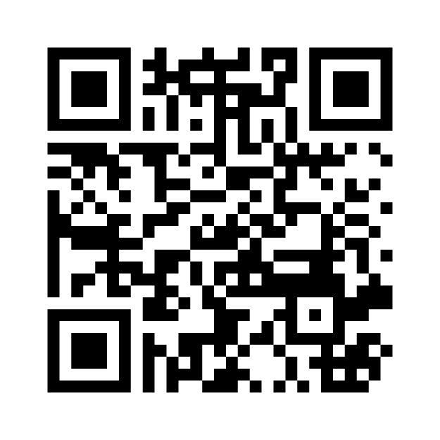
What is Social Economy?
Go to : www.menti.com
Use the code: --

Slide 6

What is Social Economy? A short video!

Slide 7
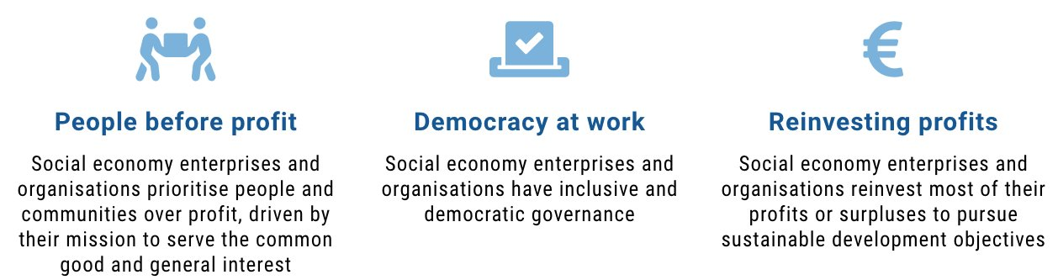
Core Values of Social Economy

Slide 8
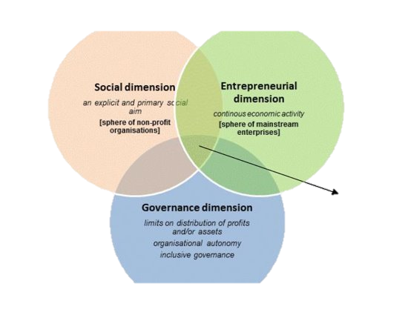
Introduction to Social Economy Organisations
Social economy enterprises are unique entities that operate in nearly every sector of the economy.
Unlike traditional businesses, their primary aim is not profit maximization but serving the needs of their communities and society.
They address critical issues such as social exclusion, discrimination, and environmental challenges.
These enterprises are guided by the principle of solidarity and aim to foster social cohesion, providing innovative solutions to the pressing needs of today’s world.

Slide 9
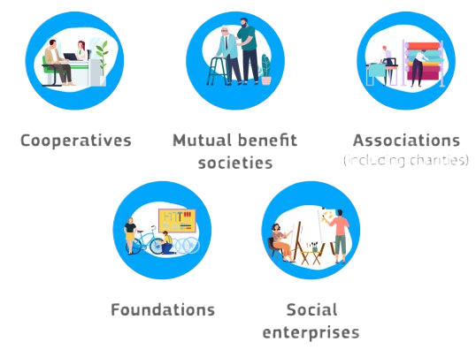
Legal Forms and Challenges
Social economy organisations have different legal forms and various objectives. They are present in almost every sector of the economy, serving the needs and interests of their communities and society.

Slide 10

Legal Forms and Challenges
The legal framework of the social economy is diverse and evolving.
The lack of a unified legal definition poses challenges for recognition and regulation. This fragmentation can hinder the growth and scalability of social enterprises. Addressing these legal ambiguities is essential for fostering an environment where social enterprises can thrive and expand their impact.

Slide 11
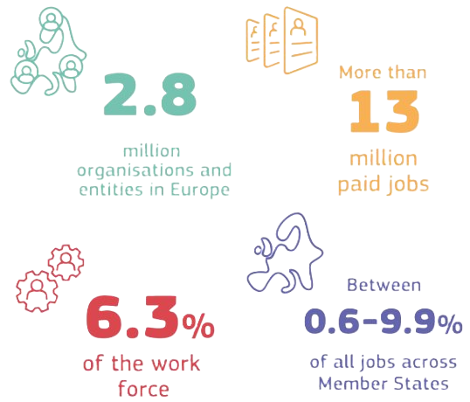
Social Economy in the EU – some numbers

Slide 12
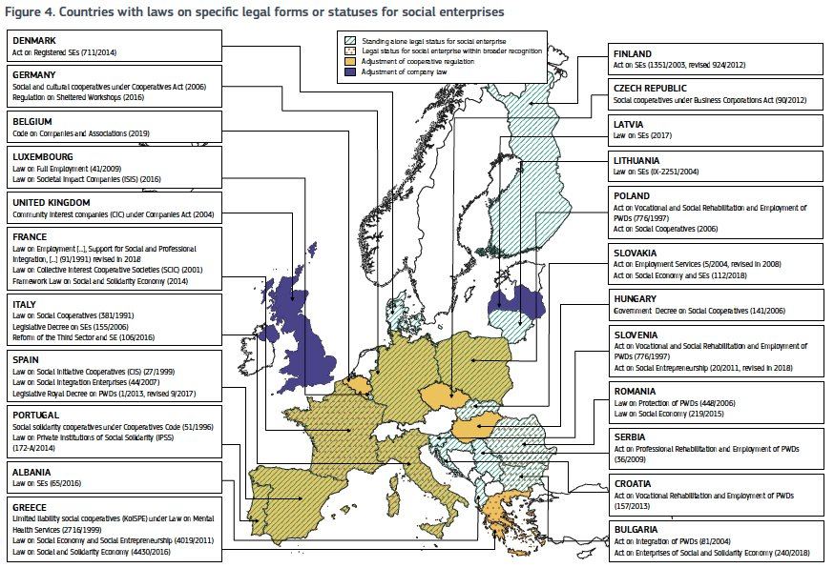
Social Economy in the EU – legal framework

Slide 13
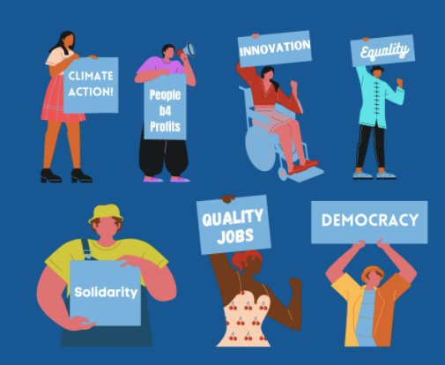
Why is the Social Economy Important?
The social economy plays a pivotal role in modern society. It acts as a bridge between economic activities and social progress, addressing the real needs of citizens.
For instance, it creates solutions to challenges like unemployment, precarious work, and climate change.
By involving citizens in problem-solving, the social economy fosters a sense of belonging and empowers individuals to take part in shaping their futures.
Moreover, it promotes inclusivity and equity, tackling discrimination and strengthening social cohesion. In essence, the social economy is a catalyst for both economic and societal progress.

Slide 14
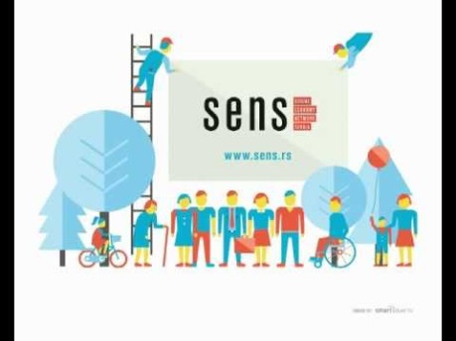
Social economy and social entrepreneurship

Slide 15


Fairbnb.coop in 90 seconds

Slide 16
From Social Enterprise to Social Entrepreneur
Social entrepreneurs are the driving force behind social enterprises. They possess a unique combination of innovation, vision, and commitment to creating positive change. These individuals identify societal issues and develop creative solutions that produce long-lasting social impact.
Unlike traditional entrepreneurs, their motivation is not financial gain but the desire to implement sustainable social changes.
They balance their focus between customers and beneficiaries, ensuring that their ventures are both socially impactful and economically viable. This dual focus highlights the transformative potential of social entrepreneurship.

Slide 17


Group activity (40 minutes)
Two groups, one social enterprise each;
Looking at the information available online, identify the main characteristic of social enteprises:
Social objective – What do you want to achieve?
Entrepreneurial activity - How do you achieve your objective?
Governance – How will the decisions be taken? How is the social enteprise structured?
Social reinvestment – How will you use the profits?

Slide 18
Social Economy in North Macedonia

Slide 19
Final test

Slide 20
CAPACITY BUILDING TO CSOs Session 5
Supporting and Developing Social Entrepreneurship (6 Hours)

Slide 21
OBJECTIVES OF THE SECOND SESSION
Developing social business plans.
Identifying sources of funding and resources for social enterprises.

Slide 22
What is the Social Business Model Canvas?
The Business Model Canvas (BMC) was developed by Alex Osterwalder and Yves Pigneur. It offers a simple, visual, one-page canvas on which we can design, innovate and dialogue about our business models.
Addressing a social impact inside a business operation is not necessarily cost neutral - so both the skills needed to deliver on a social impact and the costs involved in doing so need to be considered in designing a viable and sustainable business model.
The business model canvas should provide an opportunity to see not just the business, but also to identify the social impact they are trying to achieve. And importantly, to see clearly how the two interact.

Slide 23
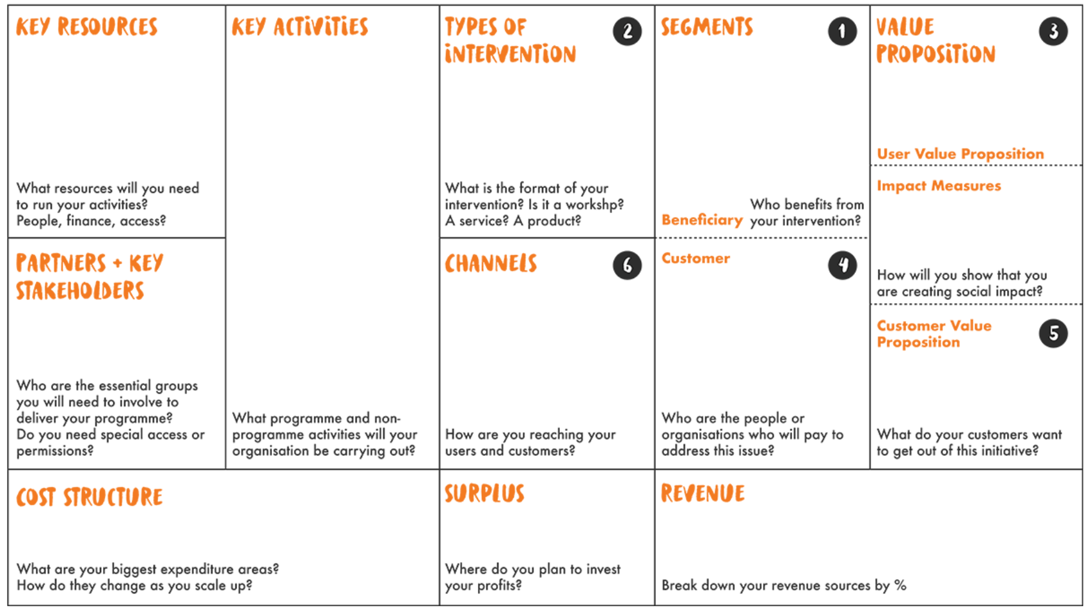
Let's take a look at the Canvas

Slide 24
Segments: Beneficiaries and customers
• Segments: Beneficiaries – describes the main beneficiaries of your social business. There are two types of beneficiaries: customers that buy your product/services and other people that can benefit without a payment. Usually a social business has beneficiaries that do not pay anything but are crucial for the business model;
• Segments: Customers – this block defines the groups of people or organizations that your enterprise aims to reach and serve. In order to better satisfy customers, you should group them into distinct segments based on various criteria: needs, behaviors, skills, interests etc. Client segmentation is very important because this offers you insights for your products development, distribution channels and so on.

Slide 25
Impact Value Proposition and Commercial Value Propositions
A social enterprise often has two value propositions
The Impact Value Proposition: (the social value you are seeking to deliver, and what makes it attractive to customers);
The Commercial Value Proposition (the goods and services you are producing and selling and what makes this attractive to costumers).
NB: you need to establish tools to measure these !

Slide 26
Channels
Channels presents the communication and distribution channels that a company use to deliver the value proposition to its customers.
These represent the customer/benficiaries touch points with your product/services and are very important.
These channels aim to: raise awareness about the company product/services among customers/benficiaries; help customer/benfiaciries to assess the value proposition; allow customers/benfiaciries to purchase product/service; provide support to customers/beneficiries.
Main questions that help you to define channels are: How are you reaching your beneficiaries and customers? How an enterprise communicates with and reaches its customer segments to deliver a value proposition?
NB: channels may o be the same for beneficiaires and costumers!

Slide 27
Key activities and types of intervention
Key Activities : describes what things a social enterprise should do to make the business work. For this you should mentioned what programme and non-programme activities will your organisation be carrying out.
Types of intervention : describes the type of product that will deliver the value. The questions that can help you to define the intervention are: What is the format of your intervention? Is it a workshop? A service? A product?

Slide 28
Partners and Stakeholders
Defines the network of suppliers and partners needed to make the social business work.
Who are the essential groups you will need to involve to deliver your programme? Do you need special access or permissions?

Slide 29
Cost, Revenues and Surplus
Cost Structure – describes all costs incurred to operate a business model. What are your biggest expenditure areas? How do they change as you scale up?
Revenue Strucutres – describe from where the revnues of your social enterprise will come from.
Surplus - describes where you plan to invest your profits.

Slide 30
Group activity (45 minutes)
Division in groups up to 4 people;
Print out a copy in A3 of the SBM Canvas
Social objective – What do you want to achieve?
Entrepreneurial activity - How do you achieve your objective?
Governance – How will the decisions be taken? How is the social enteprise structured?
Social reinvestment – How will you use the profits?
Presentation to the entire group

Slide 31
Final test

Slide 32
Thank you!

