Slide 1
CAPACITY BUILDING TO CSOs
Session 4
Design and Delivery of Quality Services to the Public (1 hour)

Slide 2
OBJECTIVES OF THE FIRST SESSION
Understand what a community needs assessment is and how to conduct it to identify potential needs and service gaps.
Basic theoretical & practical skillset of conducting a community needs assessment

Slide 3
Understand what a community needs assessment is and how to conduct it to identify potential needs and service gaps.
The first part of this session provides an overview of the process of community needs assessment and explores what results it may offer and the ways to conduct such an assessment.

Slide 4
What is CNA (Community Needs Assessment)?
Go to : http://linoit.com/users/patsaldim/canvases/CNA

Slide 5
CNA (Community Needs Assessment definition and basics
What is the purpose of the community needs assessment?
The main purpose is to collect data on community needs that will help us to gain a deeper understanding of a community's needs, gaps, and characteristics.
For example, whether there is a need for new job opportunities or easier market access for vulnerable members of the community through the creation of cooperative enterprises, or the need to create or distribute a product or service through the creation of cooperatives
At the same time this process helps to understand what resources will be needed, what assets and community stakeholders can we mobilize to meet the community needs.
E.g. whether there is a willingness of civic organizations to embrace such ventures, whether local authorities are willing to help and support cooperative ventures, whether local trade associations can help and how, etc.
Definition:
Community Needs Assessments is a process of using basic research methods and data analysis, to identify the strengths and resources available in the community to address the needs of that community. The assessment focuses on the capabilities of the community (assets), including its citizens, agencies, and organisations.

Slide 6
CNA - Basic steps
1. Specify your goals – Why you want to perform a Community Needs Assessment
The first and main step is to define the reason and the goal you want to organize and perform a CNA process.There may be different goals and reasons for CNA especially when looking at things from a social economy perspective such as:
The planning or development of a program or initiative related to the social economy in a community
E.g., the development and improvement of cooperatives, small business networks etc.
The periodic review of community needs and gaps for improvement even when there are ongoing social economy projects and initiatives in a community.
To justify grants, funding, and resource allocation connected with social economy
To simply empower communities by identifying their strengths and assets

Slide 7
CNA - Basic steps
Figure out the people and places that make up your community. Define your community by considering these questions:
Population - What is the demographic makeup of your community? Which community members are at risk? What assets do our community members offer? How could these people benefit from developing initiatives & supporting projects of social economy?
Attitudes and Values - What do the people in your community care about? What beliefs are important to consider and respect? What are the local attitudes toward certain issues for instance social economy schemes, cooperatives, local products and services, network between businesses, local supply chains etc? What biases may some people or important stakeholders hold?
Place - How will your program or initiative address and respect the places that are important? What infrastructure exists? Is there an attribute of the location that should be addressed or improved?
2. Define your community

Slide 8
CNA - Basic steps
3. Choosing Who should be involved in the CNA process
Members of the community who are experiencing the needs and who will directly benefit from the actions we are planning for the social economy. E.g. Roma residents of an area.
Staff, board members and supporters of the organisation or organisations that organise actions and perform the CNA.
Social workers and human serviceproviders operating within the community.
Local Officials. Elected local officials have significant influence and the ability to enact policies that change lives.
People with influence in the community. E.g. Roma community leaders or Roma with a successful track record in the social economy.
Experts in the social economy.
Businesses that may be affected by a gap in service or could benefit from changes and creation of new services.

Slide 9
CNA - Basic steps
4. Identify Your Community Assets/Resources
Resources, or assets, are typically tangible goods or physical features or intangible relationships and activities that may exist in your community and contribute to improving the quality of life of its residents.
These community resources and assets can be:
People: e.g. community leaders, local politicians and policy makers, key people in social economy networks or existing social enterprises, volunteers, activists and just about anyone can be an asset to a community and your organisation's efforts.
Organizations and associations: Other nonprofit organizations, local social enterprises, cooperatives, social enterprise networks, government agencies, cultural clubs, schools and all programs that help improve the quality of life for residents are assets to a community.
Locations: Any place, building or landscape can be a resource and contributor.
Equipment and tools: Items such as books, food, safety equipment, transportation or free internet access are tools that can improve people's lives.
Start by identifying the resources that are readily available to you; this may include community organizations and individuals who already provide services or financial support to assess needs and address them.

Slide 10
CNA - Basic steps
4. Identify Your Community Assets/Resources
Start by identifying the resources that are readily available to you; this may include community organizations and individuals who already provide services or financial support to assess needs and address them.
For example: Identifying organizations for Social economy.
Gather your team to brainstorm potential partnerships with associations, organizations, and other groups. Check what types of organizations & associations exist in your community supporting social economy and initiatives
For example: Identifying places linked or potentially linked with SE and local causes.
Gather your team and list the buildings, locations, and public and private spaces available to your organization. Even lots of lands not used or being abandoned that could have potential use
For example: Identifying people supporting Social economy & SE inititiatives.
Gather your team and check relevant social media groups or registered groups in the municipal archives supporting social economy, willing to create social economy networks, or wanting to develop initiatives of entrepreneurship and new products or services that are closely related to social economy.

Slide 11

Collecting data -How to conduct a CAN at a glimpse!

Slide 12
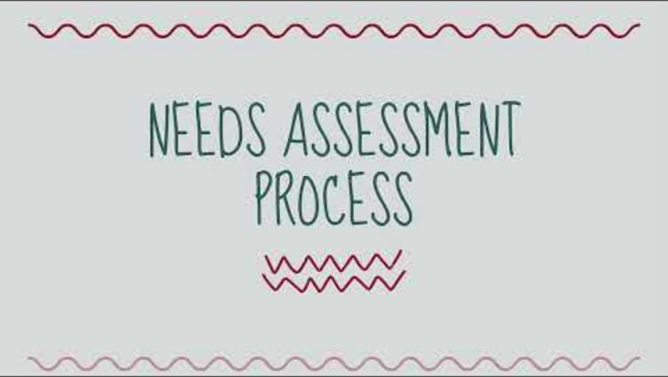
Community Needs Assessment Process & tools

Slide 13
A local example/case study of CNA in North Macedonia

Slide 14
OBJECTIVES OF THE SECOND SESSION
Understand the basics of designing services to meet identified needs.
Share experiences and learn about co-designing with communities to meet identified needs

Slide 15
Designing services to meet identified needs.
Service designing for communities Generally meet the needs brought to light by the Community Needs Assessment is a process that in the light of the social economy and entrepreneurship requires the close cooperation of NGOs with local actors and especially the members of the community itself.
Generally, the results of the Community Needs Assessment and the resulting potential recommendations for action and service design that could improve community wellbeing and meet the needs that have come to light can usually be organized into three categories:
Policy or guidance
This category includes new laws or usually new policies, and political decisions aimed at changing behaviour.
Major changes to the system
This category includes broader strategies that lead to larger systemic changes in social norms, institutions or customary practices.
Social, economic or physical changes
This category includes changes that are designed at a micro level to affect people's behaviour.

Slide 16
Examples on solutions /services to identified needs
Through the Community Needs Assessment a local NGO realizes that the urban community "X", which has a large number of Roma poor residents has serious issues with lack of fresh food and access to fresh food supply chains, faces challenges of a "food desert" and the Roma poor are in dire need of access to healthy and fresh affordable food.
Possible solution: The NGO discusses with stakeholders and the municipality and a political decision is made to establish a social grocery store providing fresh and healthy food for residents living below the poverty line free of charge, with vouchers and at half-price. The grocery store finds products from offers of shopkeepers from nearby supply chains.
The CNA found that only 20 per cent of Roma families in the 'Z' community are aware that children from low-income families are eligible for school meals and remedial teaching. While the participation of Roma children in both benefits is less than 10% in the community.
Possible solution: in order to change the situation, NGOs in the area are organizing awareness and information campaigns for parents with the participation of school principals and the District Education Officer from the Ministry. At the same time the Ministry of Education and the Ministry of Social Solidarity undertook the immediate rapid training of Roma school mediators to further facilitate the population to be approached and assisted to apply for both benefits to which they are entitled.
Through the CNA and particularly through interviews/conversations with residents, it is understood that a large number of Roma women in the community who have no jobs, and no income, are living on the edge of poverty despite producing for home use traditional spreads and dips of excellent quality.
Possible solution: Local organizations raise a sum of money [campaign funding] and train Roma women while offering legal support to create a social consortium of women for the production of spreads and dips, helping them to connect to local supply chains.

Slide 17
Developing services/actions for solutions
Based on the identified needs both the type of service action and the design of the services you will try to offer to the community, in collaboration with other stakeholders and community members, should be deeply rooted in the findings of your assessment. The development and management of these services requires a plan under which:
1. Decide which findings you will build on and which services your program or outreach will focus on to meet community needs
3. Identify potential allies and parties (e.g., policy makers, other organizations, community leaders, citizens and civic organizations, associations, etc.) that will contribute to both the planning and implementation of the action to meet the community's needs.
5. Appoint a responsible team to carry out each activity where all potential stakeholders (e.g. civil society organisations, associations) are involved and due, and set clear deadlines to move forward with actions
2. Identify an intended activity or response for each key finding, all working toward addressing the need.
4. Formulate an initial action plan which you combine with potential stakeholders, effectively involving the community itself, and listening carefully to potential end beneficiaries and their valuable insight.
6. Define indicators of success. Success indicators are metrics that show that your programme or activity has been completed or achieved a goal. Success indicators must be clear, achievable and measurable.

Slide 18
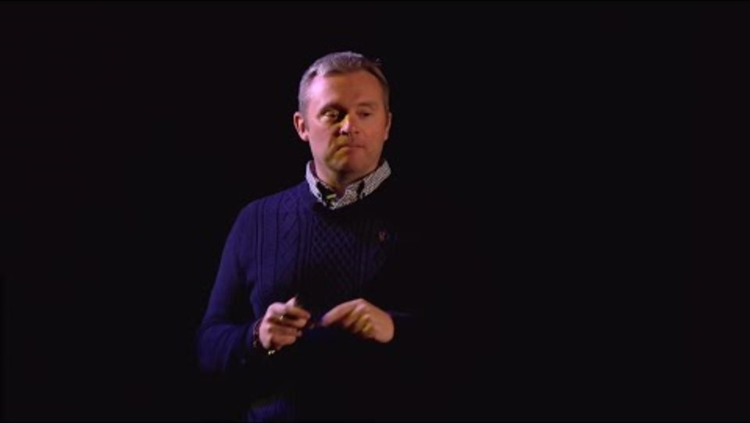
Co-operating and co-designign services/actions with the community

Slide 19
Discsussion on example local challenge and service/action in North Macedonia

Slide 20
OBJECTIVES OF THE THIRD SESSION
Understand the basics of measuring quality of services to the community
Understand the basics of measuring impact of services in the community
Share experiences and learn about methods and tools of measuring the quality and impact of services.

Slide 21
Introduction to measuring of services’ quality & impact
There are multiple ways, indicators and tools to measure the quality and impact of a service offered to the community.In this section we will briefly describe how an organization or agency can measure the quality of a service offered in the community and the impact/imprint it can have on the community.The ultimate goal of always these measurements is:
To investigate the quality and extent of the impact on the community
To reveal any problems, challenges and shortcomings in terms of the quality of service delivery so that we know where to focus to correct them
To identify challenges in terms of the range of impact in the community so that we can explore ways to widen the impact

Slide 22
What do we measure and how in quality & impact of community services
In general, the measurement of service quality depends entirely on the context, and the type of service. These factors normally regulate the types and ways of measurement. For measurement we investigate the following dimensions of a service:
Tangibles: appearance of the physical facilities, equipment, personnel and communication material of the service.
Reliability: ability to perform the promised service reliably and accurately to the public.
Responsiveness: willingness to assist beneficiaries, the public and provide prompt service.
Assurance: knowledge and courtesy of employees and their ability to convey confidence and assurance.
Empathy: the caring, personalised attention that the business provides to the public/beneficiaries/beneficiaries.
In general, to measure the impact of a community's services we focus on and address the Internal perspective (impact on society): focuses on and identifies the impact a service has on people and the community.

Slide 23
What do we measure and how in quality & impact of community services
These five or six with impact dimensions are used to measure the gap between the beneficiaries'/public's expectations of excellence in terms of the service provided and their perception of the actual service provided.
When properly examined over time, these dimensions help us to understand both the expectations of beneficiaries/public in a community, as well as the perceptions of specific services that the public has and the areas that need quality improvement.
The most reliable and direct way to measure the quality of a community's services is:
Anonymous service quality questionnaires from the beneficiaries/beneficiaries of these services
Short interviews with beneficiaries/beneficiaries of these services.
Questionnaires can be completed on paper in the service and also by email. While correspondingly on the beneficiaries' side or short telephone direct interviews are useful.

Slide 24
Questions in questionnaires or tele-interviews about the quality & impact of services
There are many types of questions that can be asked in a service quality questionnaire as well as in a tele-interview. Our focus has to be on the interaction with the service/employees in terms of service to ease of use and cover all 5 dimensions mentioned above Tangibles, Reliability, Responsiveness, Assurance, Empathy) along with questions about the impact & importance of the service in everyday life, community, social life. It is also good to have some open text questions so that your clients can write their own comments.
Small examples of questions may include the following :
The representative was helpful (strongly agree to strongly disagree)
What qualities about the service did you like (include a list of patient, friendly, attentive, willing to help, empathetic, etc.)
Was there anything about our service that made an impression on you? (open text response)
In the next 12 months, how likely are you to use our product or service again (strongly agree to strongly disagree)

Slide 25
Example of Quality & Impact Questionnaire in North Macedonia & question finding activity

