Slide 1
Capacity BUILDING TO
CSOs Session 3
Communication with the Public and Stakeholders

Slide 2
OBJECTIVES OF THE FIRST SESSION
The participants to learn to communicate effective and to understand the importance of the clear communication;
The participants will learn different type of social media to reach the stakeholders;
The participant will now how to manage the public relations and crisis communication.

Slide 3

Why is effective communication important?
  Builds strong relationships
  Increases productivity and efficiency
  Reduces misunderstandings and conflicts

Slide 4


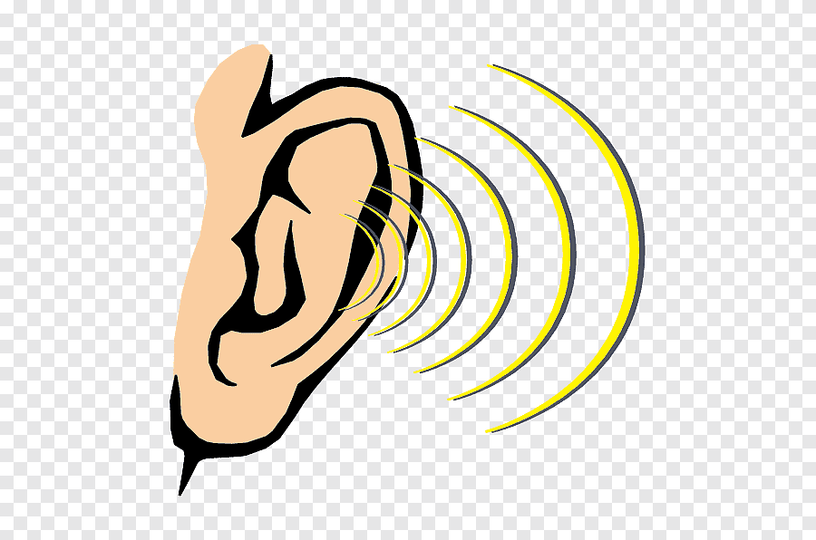

Key Components of Effective Communication
Clarity: Message should be simple and easy to understand.
Conciseness: Use as few words as possible without losing meaning.
Active Listening: Listening attentively and giving feedback.
Non-Verbal Cues: Body language, facial expressions, and tone of voice.
Context Awareness: Tailoring your message to your audience.

Slide 5
Examples of Effective Communication
Business Example
Customer Service Example
  Ineffective: "We need to move forward with the project as soon as possible because if we don't, we could face delays, and this would affect everything."
  Effective: "Let’s move forward with the project to stay on schedule and avoid potential delays."
  Ineffective: “Company policy doesn’t allow refunds.”
  Effective: “I understand your concern. Unfortunately, our policy doesn’t allow refunds, but I can offer you a store credit or exchange."

Slide 6
Active Listening
What is Active Listening?
  Focused, attentive listening with the intent to understand.
Techniques to Practice Active Listening
  Maintain eye contact.
  Nod or give verbal cues (e.g., "I see," "I understand").
  Paraphrase to confirm understanding (e.g., “So what you’re saying is…”).

Slide 7

Exercise – Active listening

Slide 8
OBJECTIVES OF THE SECOND SESSION
Using Social Media as a Communication Tool for Stakeholders;
The participants to learn more about different types of social media and their usefulness;
The participant will now how to manage appropriately the social media based on the different targets and audience.

Slide 9
Why Social Media?
Widespread Reach: Global audience, easy access
Cost-Effective: Budget-friendly compared to traditional media
Real-Time Communication: Instant engagement with stakeholders
Interactive: Facilitates two-way communication and feedback

Slide 10





Choosing the Right Platform
Facebook: Best for customer engagement, community building, and updates
LinkedIn: Ideal for B2B communications, professional networks, and thought leadership
Twitter: Quick updates, customer service, and industry news
Instagram: Visual storytelling, brand awareness, and influencer partnerships
YouTube: Video content for detailed explanations, tutorials, or interviews

Slide 11
Tailoring Communication to Different Audiences
For Employees: Use internal social networks (e.g., Slack, Microsoft Teams)
For Customers: Use customer-centric platforms (e.g., Facebook, Instagram, Twitter)
For Investors: Share updates through LinkedIn and corporate websites
For Suppliers: Industry-specific platforms or LinkedIn groups
General Tips: Adjust tone and content to match the platform and audience

Slide 12
Tools for Effective Social Media Communication
Hootsuite: Schedule posts, monitor conversations, and track performance
Canva: Easy design tool for creating engaging graphics
Buffer: Simplifies scheduling and content planning
Sprout Social: Social media management and analytics tool
Trello: Content calendar for organizing social media strategies

Slide 13
Future Trends in Social Media Communication
AI and Chatbots: Automated responses for quick engagement
Video Content: Increased use of live streams and video content
Personalization: Targeted content based on user interests
Ephemeral Content: Short-lived posts to create urgency (e.g., Stories on Instagram/Snapchat)

Slide 14
OBJECTIVES OF THE THIRD SESSION
Understanding of the importance of PR in one organization and the different models of PR;
The understand the crisis management and to learn how to use different models of crisis management

Slide 15
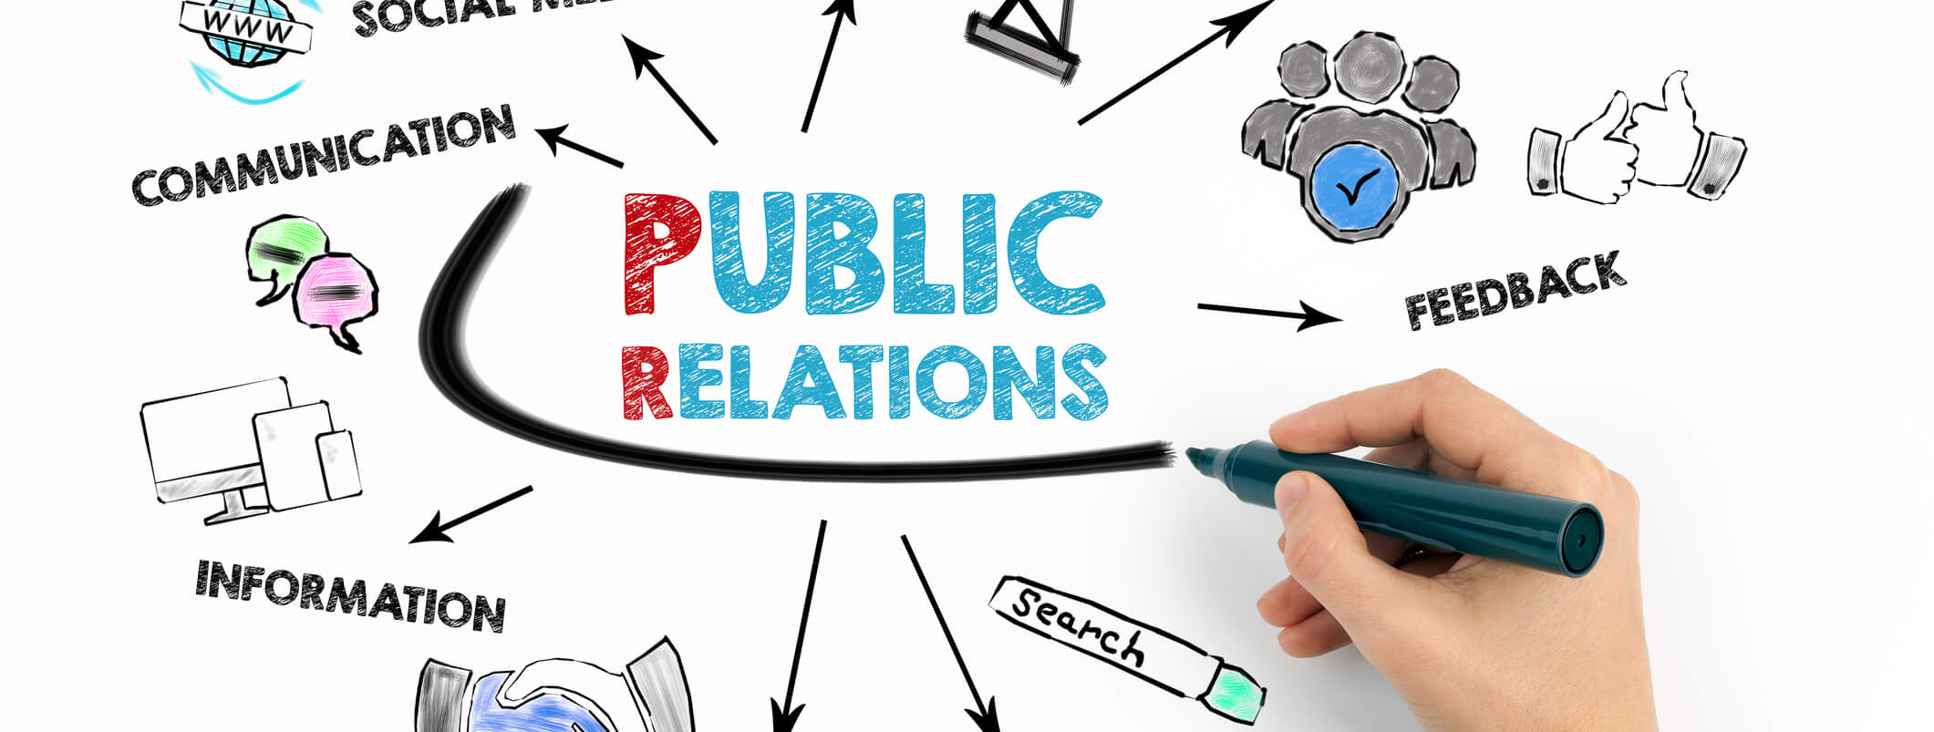
Public Relations

Slide 16
Introduction to Public Relations
Definition: Public Relations is the practice of managing the spread of information between an organization and its publics.
Objective: Build and maintain a positive image, foster goodwill, and establish relationships with key stakeholders.

Slide 17
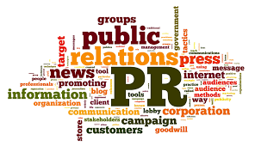
Key PR Functions
Media Relations: Building strong media partnerships to spread key messages.
Internal Communication: Ensuring employees are well-informed and motivated.
Brand Management: Shaping the public’s perception of a brand or organization.
Public Engagement: Interacting with the public through events, CSR activities, etc.

Slide 18
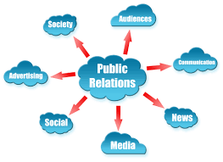
Types of PR
Proactive PR: Planning ahead and shaping public perception.
Reactive PR: Responding to public issues and challenges as they arise.
Crisis PR: Managing communication during and after a crisis.

Slide 19
What is Crisis Communication?
Definition: Crisis communication is the process of managing a public relations crisis to protect the organization’s reputation and reduce damage.
Purpose: Communicate effectively to protect the brand, inform stakeholders, and minimize harm during unexpected situations.

Slide 20

Crisis Communication Goals
Protect the Organization’s Reputation: Respond quickly and transparently to manage perceptions.
Maintain Stakeholder Trust: Keep employees, customers, investors, and the public informed.
Minimize Damage: Prevent the crisis from spiraling and causing long-term damage.
Recover and Rebuild: After the crisis, focus on restoring the organization’s image.

Slide 21
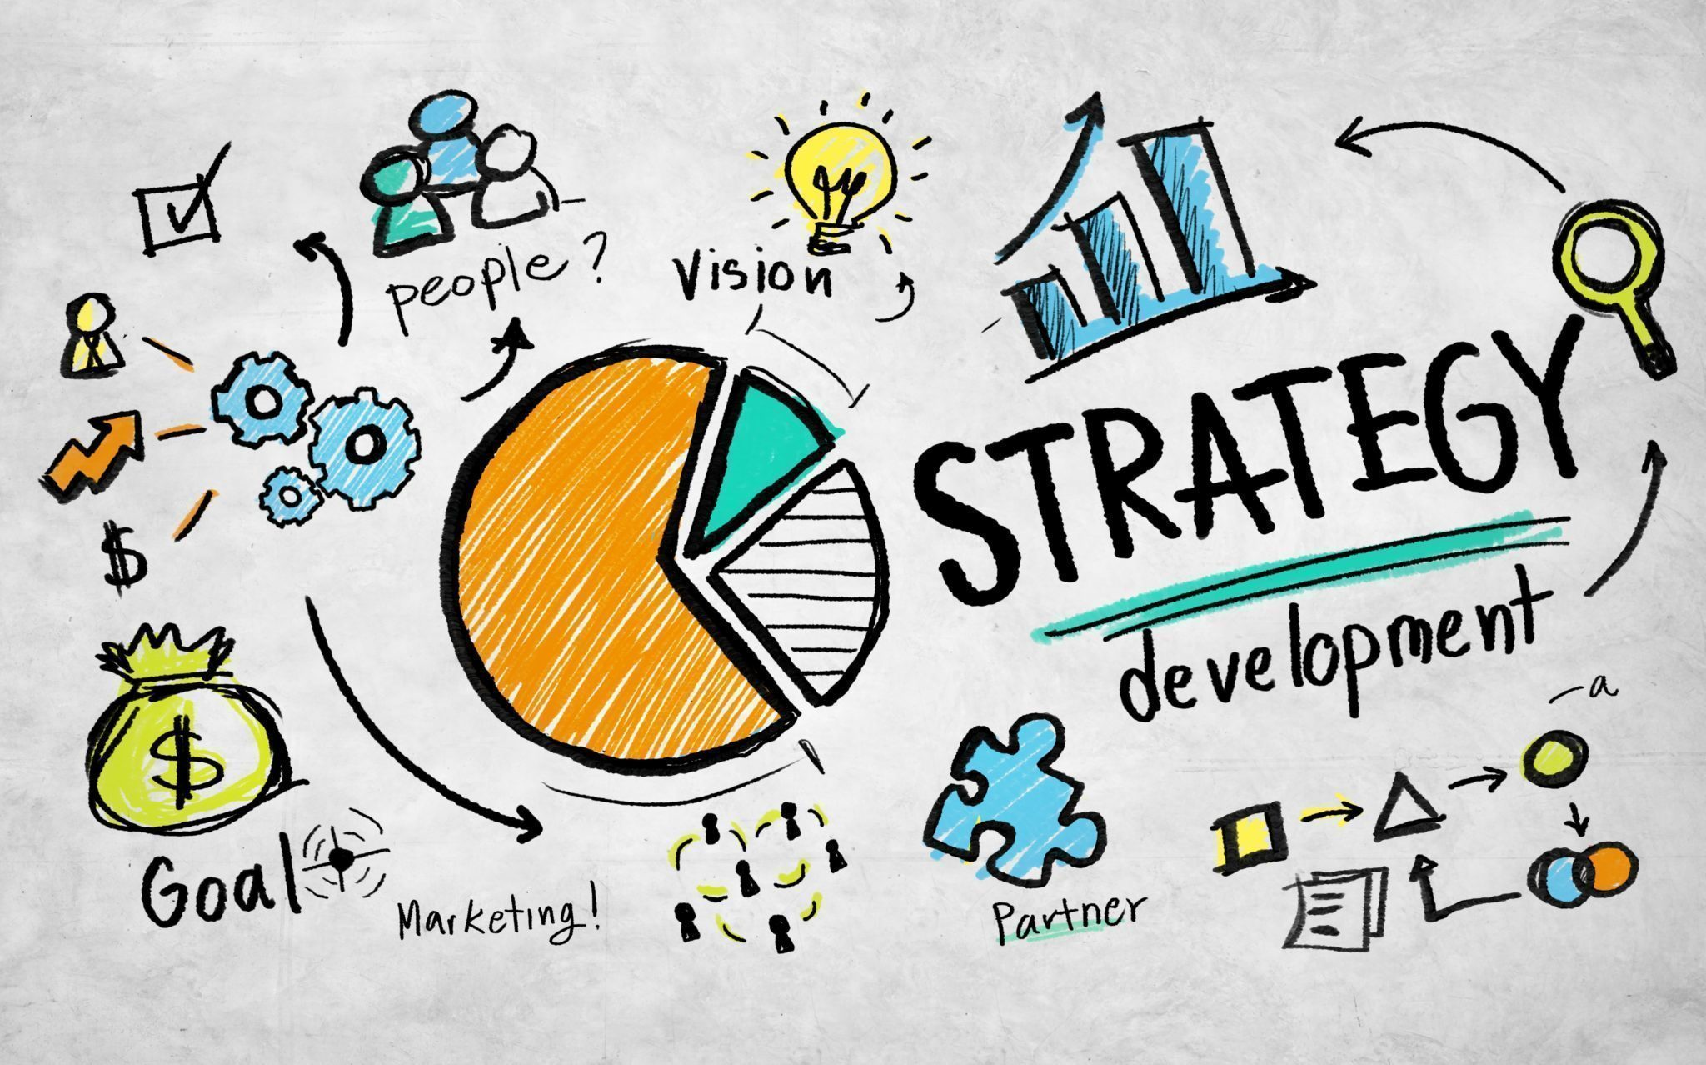
Crisis Communication Strategies
Be Prepared: Develop a crisis communication plan.
Respond Quickly: Time is critical—communicate as soon as possible.
Transparency: Acknowledge the issue and be honest about the facts.
Designate Spokespersons: Ensure consistent messaging across channels.
Regular Updates: Keep stakeholders informed throughout the crisis.

Slide 22
Crisis Communication Tools
Press Releases: Official statements to the media.
Social Media Updates: Quick and accessible updates through social platforms.
Press Conferences: Formal statements in front of the media.
Internal Communications: Direct updates to employees through emails, meetings, etc.

Slide 23
The Role of Social Media in Crisis Communication
Speed: Social media allows for rapid response.
Engagement: Respond directly to public concerns and questions.
Monitoring: Track social media conversations to manage perceptions.
Transparency: Use social media for real-time updates during a crisis.

Slide 24
Conclusions
Summary: Effective PR and crisis communication are vital for an organization’s long-term success. A solid PR strategy builds strong relationships, while crisis communication helps mitigate damage during challenging times.
Final Thought: Preparation, transparency, and quick action are keys to managing both PR efforts and crisis communication effectively.

Slide 25
Thank you for your kind attention.

