Slide 1
Capacity BUILDING TO
CSOs Session 2
Strategies for Engaging with Local Government and Businesses

Slide 2
OBJECTIVES OF THE FIRST SESSION
Discuss effective approaches for engaging authorities and businesses.
The participants will learn about the tips and strategies for approaching to the local authorities and businesses;
The participant will understand the importance of using of the local resources and connections with different stakeholders.

Slide 3
Key Points
  Importance of building trust
  Different strategies for each target group
  Tailoring communication to each context

Slide 4
Understanding Authorities vs. Businesses
Authorities:
  Government, regulatory bodies, or other official entities
  Focus on compliance, legal frameworks, and public service
Businesses:
  Corporations, small enterprises, or startups
  Focus on ROI, partnerships, and profitability

Slide 5
Preparing Your Approach
Research:
  Understand the interests, goals, and challenges of your target.
Tailored Proposal:
  Focus on how your proposal aligns with their priorities.
Clear Communication:
  Simplify your message to avoid overwhelming the recipient.

Slide 6
Approaching Authorities
Know the Regulations:
  Understand laws, policies, or procedures that may affect your request.
Leverage Public Interest:
  Highlight the potential public benefits of your proposal.
Be Formal and Professional:
  Use a respectful tone and formal language.
Follow Protocol:
  Ensure you’re aware of necessary steps, paperwork, and timelines.

Slide 7
Approaching Businesses
Value Proposition:
  Emphasize how your product or service adds value to their business.
Network and Referrals:
  Utilize personal networks or industry connections for introductions.
Be Concise and Clear:
  Be direct and make your offer clear in the first few interactions.
Build Long-Term Relationships:
  Position your approach as part of an ongoing relationship, not just a one-time transaction.

Slide 8
Building Long-Term Relationships
Stay Engaged:
  Follow up periodically and show genuine interest in their success.
Offer Continued Value:
  Ensure that your contributions are consistent and valuable over time.
Share Success Stories:
  Provide case studies, testimonials, or results that showcase your success.

Slide 9

Guest speaker – Business representative
Key challenges in cooperation with the local authorities
Benefits from the good relationship with the local authorities
Importance of the cooperation with the local partners

Slide 10
OBJECTIVES OF THE SECOND SESSION
Identifying the mutual benefit of the cooperation with the local authorities and businesses;
The participant will learn about the different strategies of cooperation with the local authorities and businesses.

Slide 11

Why the cooperation with the local authorities and businesses is crucial for your NGO?

Slide 12
Mutual benefit of the cooperation with the local stakeholders
Access to the different resources on a local level;
Increasing Reach and impact of the broader network and communities;
Policy influence;
Expertise and knowledge sharing;
Sustainability;
Legitimacy and trust.

Slide 13
Importance of CSO and Stakeholder Partnerships
Why are these partnerships crucial?
  Enhance community development: Stakeholders bring local knowledge, while CSOs provide expertise in social change.
  Create sustainable solutions: Collaboration ensures that solutions are contextually appropriate and lasting.
  Strengthen local ownership: Local stakeholders are more likely to invest in projects they have helped shape.

Slide 14
Mutual Benefits for CSOs and Local Stakeholders
For CSOs
  Increased effectiveness: Access to local insights and networks.
  Sustainability: Partnerships ensure long-term success through local ownership.
  Enhanced legitimacy: Gaining trust and buy-in from the local community.
For Local Stakeholders
  Access to expertise: CSOs often have technical knowledge and resources.
  Improved service delivery: CSOs bring innovative solutions to local issues.
  Capacity building: Stakeholders improve skills and infrastructure through collaboration.

Slide 15
Tips for Successful Partnerships
1. Build Trust
  Open, transparent communication is key.
  Example: A CSO working with a local community health center might ensure regular meetings to align on objectives and processes.
2. Foster Mutual Respect
  Recognize and value the expertise of both parties.
  Example: A CSO working with local businesses should acknowledge the local business owners' knowledge of the community's economic needs.

Slide 16
Tips for Successful Partnerships
3. Set Clear Goals and Expectations
  Both parties should have a shared understanding of the project’s outcomes.
  Example: A partnership between a CSO and a local environmental group could involve clear agreements about environmental restoration targets.
4. Be Adaptable and Open to Feedback
  Be open to modifying strategies as necessary.
  Example: A CSO working with local farmers might adapt agricultural techniques based on the farmers' feedback.

Slide 17
Key Takeaways
Mutual benefits come from:
  Trust, respect, and shared goals.
  Leveraging both local expertise and external resources.
A well-structured partnership leads to sustainable community development.
Always engage in feedback loops to keep the partnership dynamic and effective.

Slide 18
OBJECTIVES OF THE THIRD SESSION
The participants will learn the basic communication skills;
The participants will learn the basic negotiation skills;
Learn essential communication and negotiation strategies to enhance relationships, achieve goals, and resolve conflicts.

Slide 19

What is Communication?

Slide 20


Types of Communication:
  Verbal: Spoken or written words
  Non-verbal: Body language, gestures, eye contact

Slide 21
Core Communication Skills
Clarity and Conciseness: Get to the point without unnecessary details.
Active Listening: Pay full attention, ask questions, and provide feedback.
Empathy: Understand the emotions and viewpoints of others.
Confidence: Express your ideas clearly and assertively.
5. Body Language: Ensure non-verbal cues align with the message

Slide 22
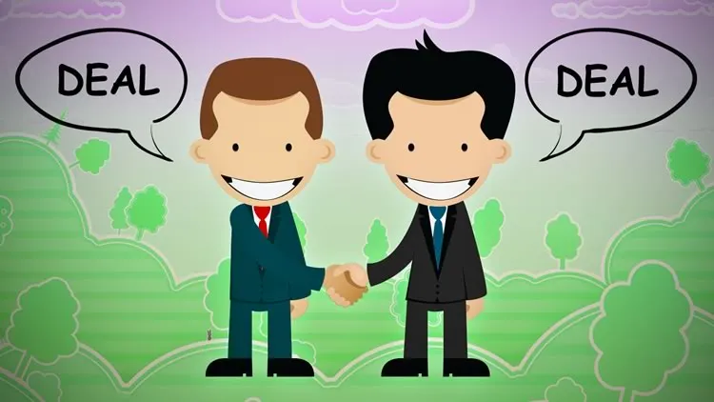
What is Negotiation?

Slide 23
Key Elements of Negotiation
Preparation: Know what you want, understand the needs of the other party.
Clear Objectives: Define goals before entering negotiations.
Flexibility: Be open to alternative solutions.
Effective Communication: Share information clearly and listen actively.
Problem-Solving: Focus on resolving the issue, not on winning.

Slide 24
Negotiation Strategies
BATNA (Best Alternative to a Negotiated Agreement): Know your alternatives.
ZOPA (Zone of Possible Agreement): Identify the range where both parties’ interests align.
Anchoring: Set the starting point for negotiations.
Concessions: Plan what you can offer and where you can make compromises.

Slide 25
Practical Tips for Effective Negotiation
Know your limits: Understand your minimum acceptable deal.
Build rapport: Establish trust and understanding with the other party.
Remain patient: Don’t rush into a deal; take time to assess options.
Control emotions: Stay calm and composed under pressure.

Slide 26
Common Pitfalls in Communication and Negotiation
Overgeneralizing: Making broad assumptions without evidence.
Interrupting: Preventing the other party from speaking.
Being too rigid: Not being willing to compromise or adjust your stance.
Emotional reactions: Letting frustration or anger cloud judgment.

Slide 27

Exercise - BATNA

Slide 28
Conclusions
Strong communication and negotiation skills are critical for professional and personal success.
Practice active listening, empathy, and clarity.
Be prepared for negotiations, and always look for mutually beneficial solutions.

Slide 29
Thank you for your kind attention.

