Slide 1
Capacity BUILDING TO
CSOsSession 1
Introduction to Networking and Coalition Building

Slide 2
OBJECTIVES OF THE FIRST SESSION
Identifying potential partners and stakeholders (local government, business, community leaders)
The participants to learn about the elements that characterize the practices of the partnership and coalition building

Slide 3

What do you see in the picture?

Slide 4

What is a partnership ???
A vehicle that connects people and organizations;
A means that connects organizations to each other;
A tool that connects organizations, institutions, the business sector.

Slide 5
What is a partnership ???
A means that improves communication and cooperation among those who share the same vision, values or purpose;
Facilitates and enhances the process of information exchange between different sectors and parties;
Helps to achieve goals that an organization cannot achieve.

Slide 6

Elements to consider in networking and partnership
Leadership
Common understanding;
Shared vision, interests and goals;
Culture and values;
Learning and development
Communication
Resource equalisation;
Developing and maintaining trust.

Slide 7
Key components for establishing a partnership
Identify the need for partnership;
Identify key stakeholders for the need and their interest to be part of the partnership;
Identify the main things that all potential partners want to achieve through partnership or networking;
Identify the main barriers to partnership;
Focus on added value for the partnership (Ask yourself, “How can we achieve more or better results through collaboration? ")

Slide 8
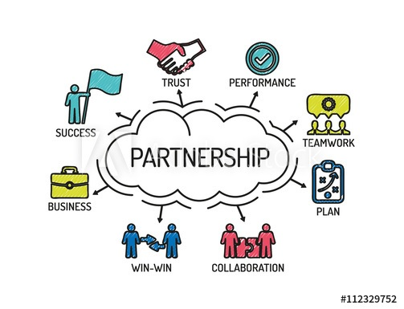
Successful partnership

Slide 9

Exercise 1 – checking of potential partnership

Slide 10

Principles of partnership and coalition
Participatory,
Representativeness,
Delegation
Long-term goals and planning,
Synchronizing the activities of organizations and financial stability (cost sharing).

Slide 11
Barriers to successful networking and coalition building
Limited vision / failure to inspire;
One partner manipulates or dominates the other partners;
If partners compete for leadership;
Lack of clear purpose and inconsistent level of understanding of the purpose of the partnership;
Unclear allocation of roles and responsibilities of each partner;
Lack of support and cooperation from partner organizations;
Differences in philosophies and ways of working;
Lack of commitment by partners;

Slide 12

Barriers to successful networking and coalition building
Inequality and inadequate balance of power and control;
Key interests and / or people are missing in the partnership;
Hidden agendas;
Failure to communicate;
Lack of evaluation or monitoring systems;
Failure to learn and develop the human capacity and capacity of organisations involved in the network or partnership;
Financial and time commitments outweigh potential benefits;
Too little time for effective consultations.

Slide 13

Types of partnerships
Partnerships among community-based Non-profit service organizations;
Cross-sector partnerships;
Partnerships between donors and organizations;
Cooperation or project partnerships;
Strategic partnerships;

Slide 14
Types of partnerships
Cooperation or project partnerships;
Strategic partnerships;
Strategic partnerships or alliances;
coalitions, and
Partnerships and networks according to the level of activity and geographical coverage.

Slide 15

Partnership Formation and Networking Process
Defining the need for partnership;
Starting the process;
Establish and maintain the partnership.

Slide 16
Analysis of potential partnerships
EXAMPLE OF AN ANALYSIS OF POTENTIAL PARTNERSHIPS
REF
++-
++-
+++
20
Slobodan Stojkov
Stojan Efremov
+++
++-
EC
+++
Mira Skarich
Abdulbaki Suleiman
+++
+++
++-
+-
|||UNTRANSLATED_CONTENT_START|||Сонце Тетово|||UNTRANSLATED_CONTENT_END|||
MES
Italy
MCIC
+++
+-
++-
++
ISPSI
Greece
RRC
+++
+++
++-
Minister without Portfolio
Students
++
++
+-
Agency for the Exercise of Community Rights under 20%
20 Roma organizations
++
+++
15 members of the IRIC
MLSP
Sorabotka
Komunikacija
Konkurencija
Korisnici
Donatori

Slide 17
Exercise 2 – Analyzing of potential partnership

Slide 18
Conclusions
Key Takeaways:
  Building a coalition requires trust, clear communication, and a shared vision.
  Effective leadership, adaptability, and sustainability are key to success.
Final Thought:
Strong coalitions have the power to create lasting social, environmental, or political change.

Slide 19
Thank you for your kind attention.

